Slide 1

Stage 2 Bigger Than You Realize Course Designer: Eric Beerbaum
Bigger Than You Realize is an 18 round, 90 point COMSTOCK medium course. There are seven USPSA targets and four steel targets. The best two hits per target will score. Steel must fall to score. The start signal is audible.
The Handgun start position is standing anywhere in the shooting areas, handgun loaded and holstered, wrists above shoulders. The PCC start position is standing anywhere in the shooting areas, PCC loaded, safety on, held over shoulders.
On the audible start signal, engage targets from within the shooting areas.

Slide 2
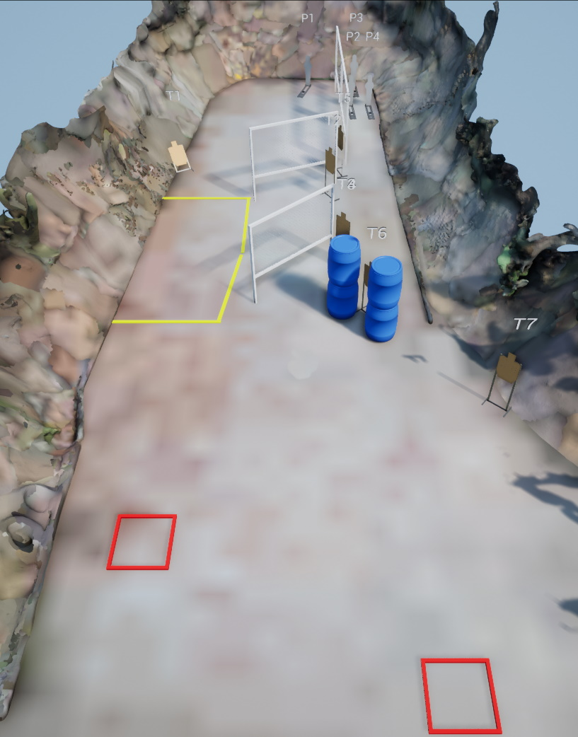
 | Stage 2 Bigger Than You Realize Course Designer: Eric Beerbaum

